Slide 1
Section 3.9 Related Rates
Lecture 1
Connected quantities, connected change

Slide 2

Homework Submission to Canvas
Preview of section
Skim the section in text and write a short paragraph summary.
Give a bulleted list of all important definitions, theorems, and formulas without details.
Notes on video lectures
Take notes on everything written on slides including all details, worked examples, on-own activities, as well as your own thoughts and questions.
Try on-own activities first, then write down provided solution next to it for comparison.
Worked examples from the text
Write down the problem and attempt without looking at the solution.
Use the solution to write the best explanation you can.
Solutions to textbook exercises
Model approaches and explanations given in the video lectures and textbook examples.
Final reflection of section
List the key takeaways to remember as a bulleted list.
Video reflection (for some sections)
Write a 1 paragraph reflection on the video discussing what you found most interesting or useful.

Slide 3

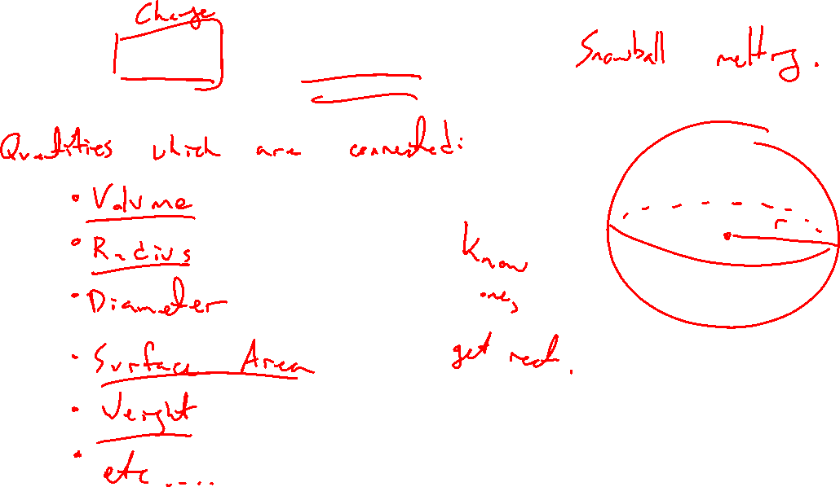
Which rates are related?
Notes:
Snowball melting youtube. List all things changing. Which are connected?
https://www.youtube.com/watch?v=LNEBZ8ekU18
Volume of sphere formula. Time as vatiable.

Slide 4
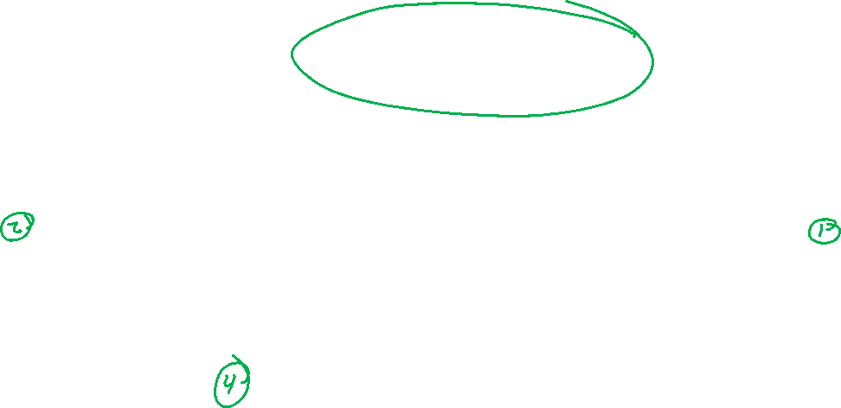
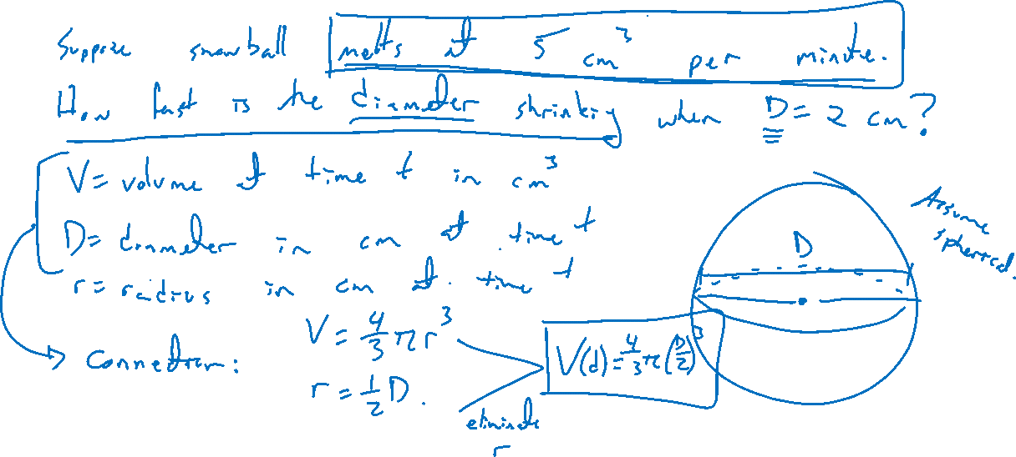
Example: Snowball melting
Notes:
Suppose snowball is melting at 5 cm^3 per minute. How fast is the diameter shrinking when r=4cm?
Steps: Picture, assign variables, rates as derivatives comb with data, equation relating all vars, implicit differentiation

Slide 5
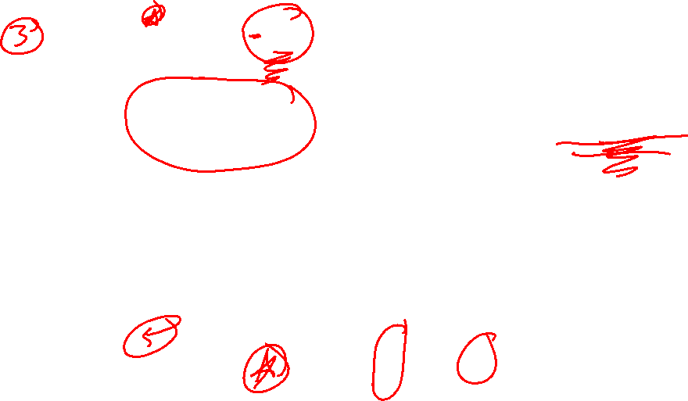
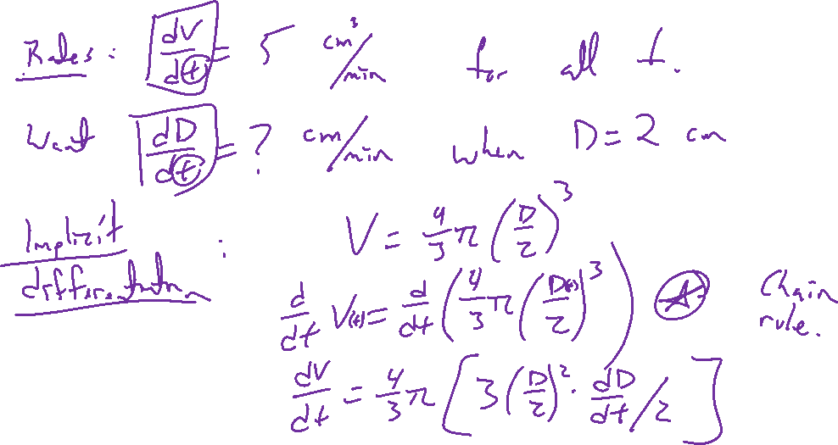
Example: Snowball melting
Notes:
Suppose snowball is melting at 5 cm^3 per minute. How fast is the diameter shrinking when r=4cm?
Steps: Picture, assign variables, rates as derivatives comb with data, equation relating all vars, implicit differentiation

Slide 6
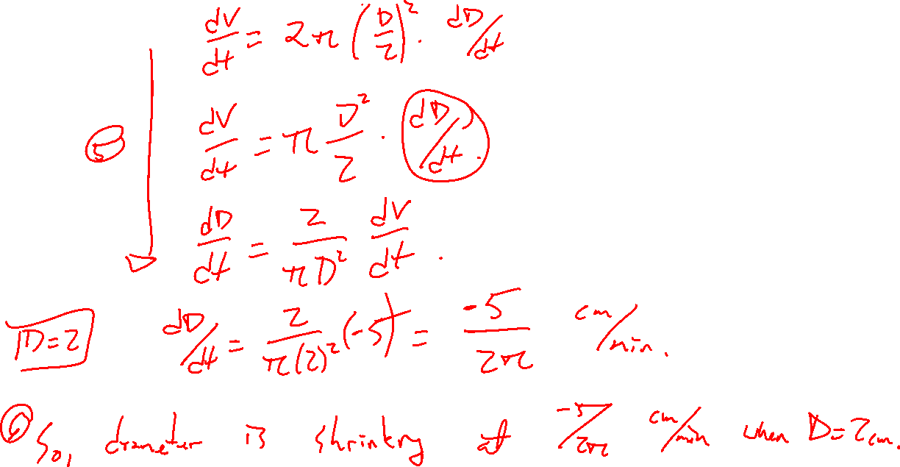

Slide 7
Example: Snowball melting
Notes:
Suppose snowball is melting at 5 cm^3 per minute. How fast is the diameter shrinking when r=4cm?
Steps: Picture, assign variables, rates as derivatives comb with data, equation relating all vars, implicit differentiation

Slide 8
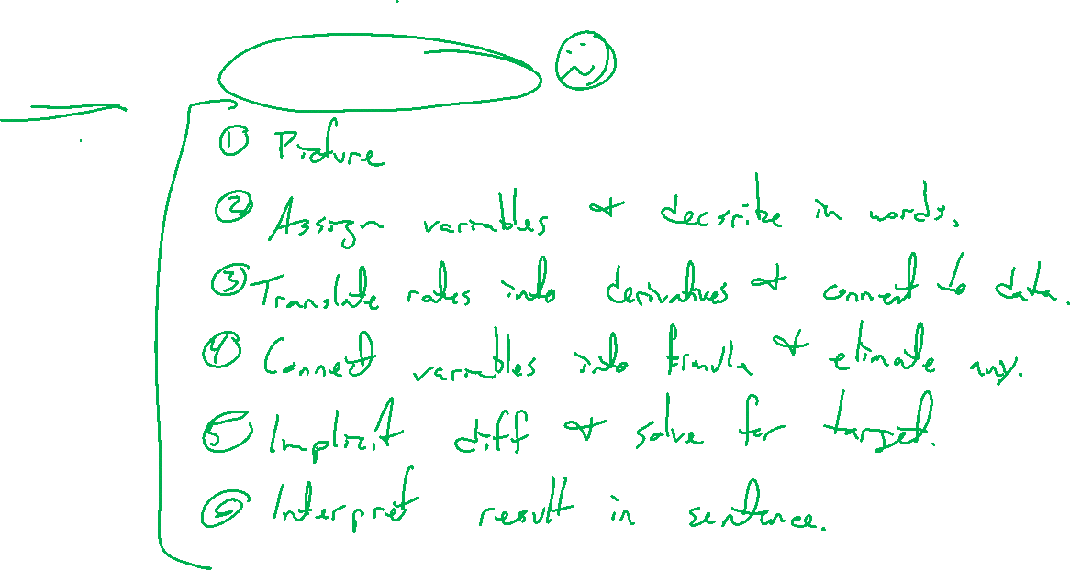
Steps for Related Rates
Notes:
Steps: Picture, assign variables, rates as derivatives comb with data, equation relating all vars, implicit differentiation, interpret solution

